Slide 1
Deep Learning
01

Slide 2
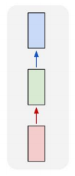
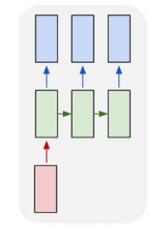
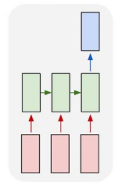
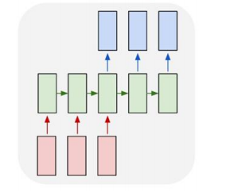
Deep Learning — Input / Output
one to one
one to sequence
sequence to one
sequence to sequence

Slide 3
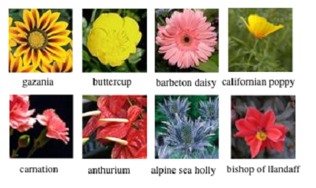
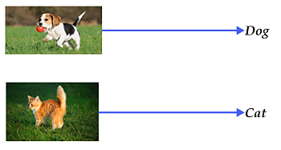
Deep Learning — Input / Output
one to one
图像分类
AlexNet[1], VGGNet[2], GoogLeNet[3], ResNet[4]

Slide 4
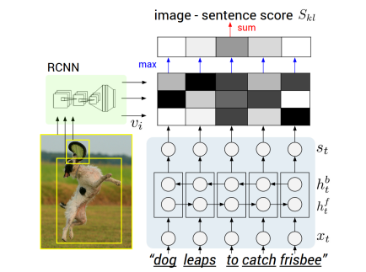
Deep Learning — Input / Output
one to sequence
图像描述（字幕）
[5]

Slide 5
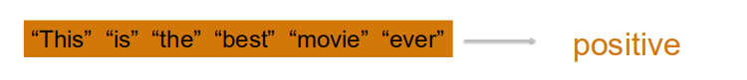
Deep Learning — Input / Output
sequence to one
情感分析

Slide 6
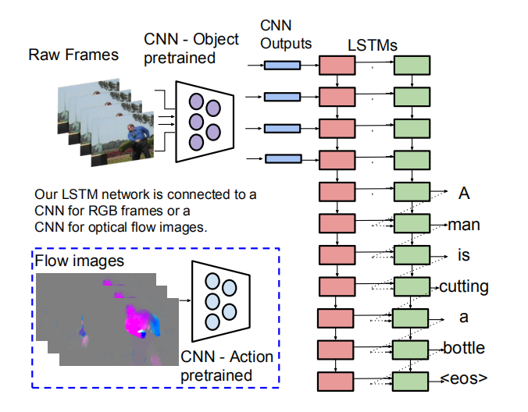
Deep Learning — Input / Output
sequence to sequence
视频描述

Slide 7
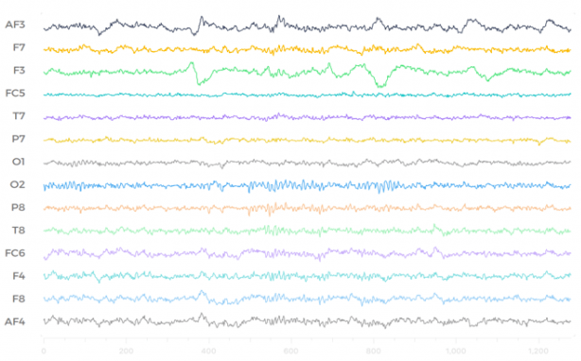
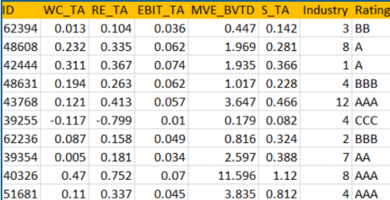
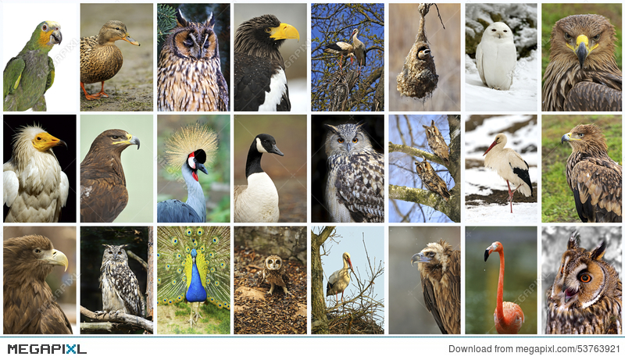
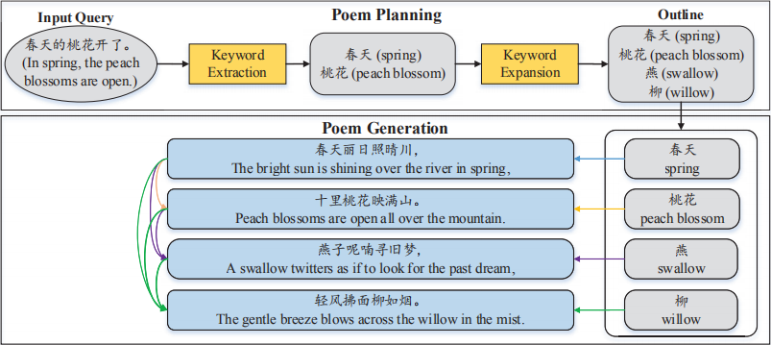
数据集类型
数值类型
时间序列、
文本数据
图像数据
ML, LSTM
CNN
LSTM

Slide 8
Deep Learning for Video Application
02

Slide 9
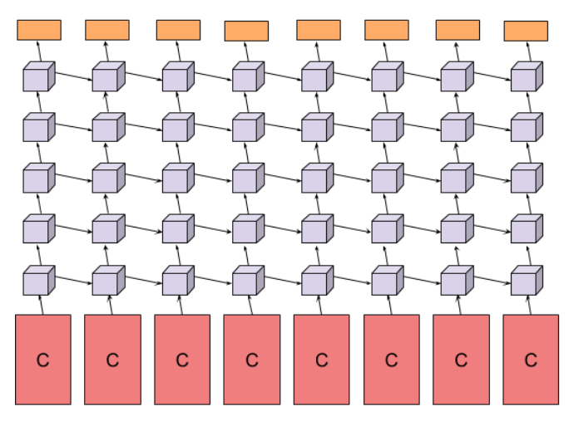
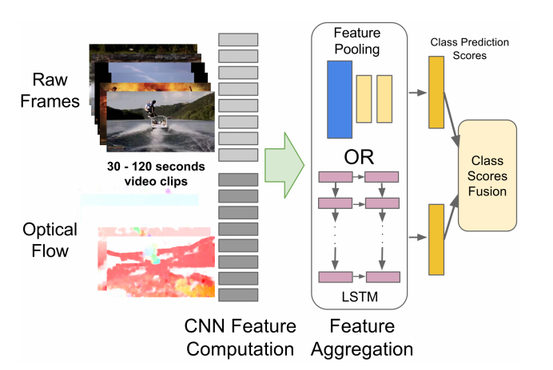
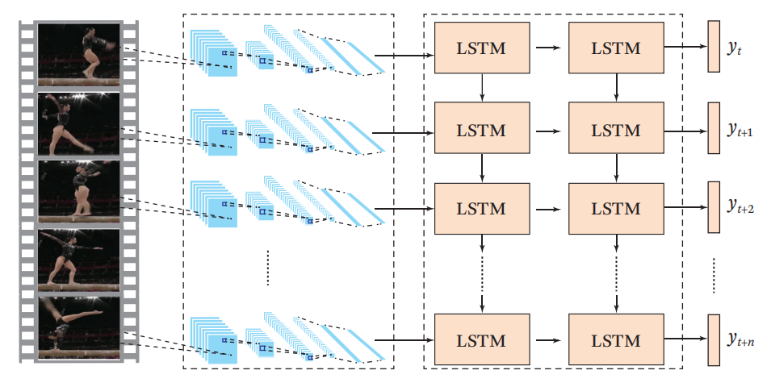
Video Classification
[6]
[7]

Slide 10
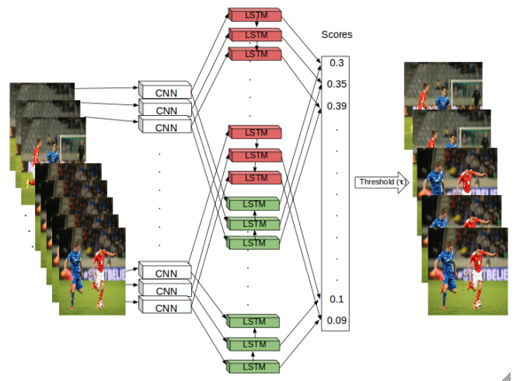
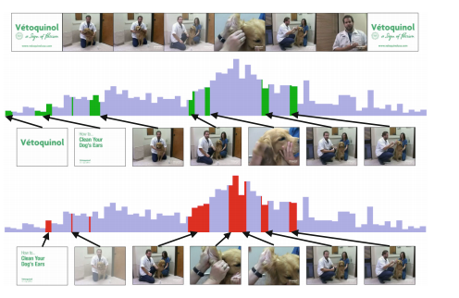
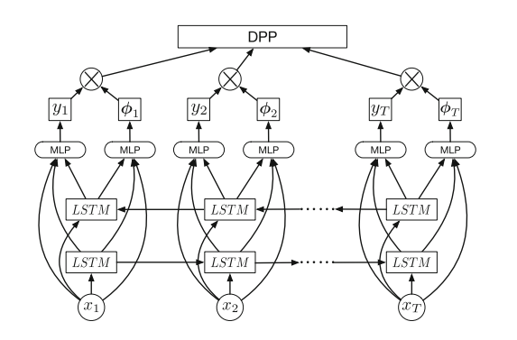
Video Summarization
[8]
[9]

Slide 11
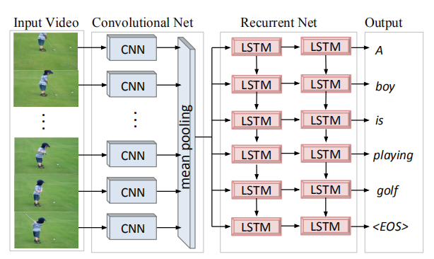
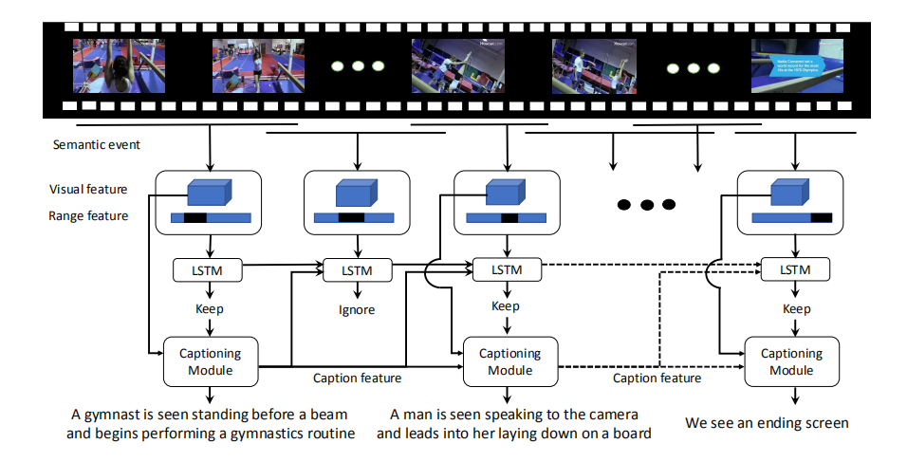
Video Captioning
[10]
[11]

Slide 12
A Semantic-based Method for
Visualizing Large Image Collections
Xiao Xie, Xiwen Cai, Junpei Zhou, Nan Cao, Yingcai Wu
IEEE Transactions on Visualization and Computer Graphics (2018)

Slide 13
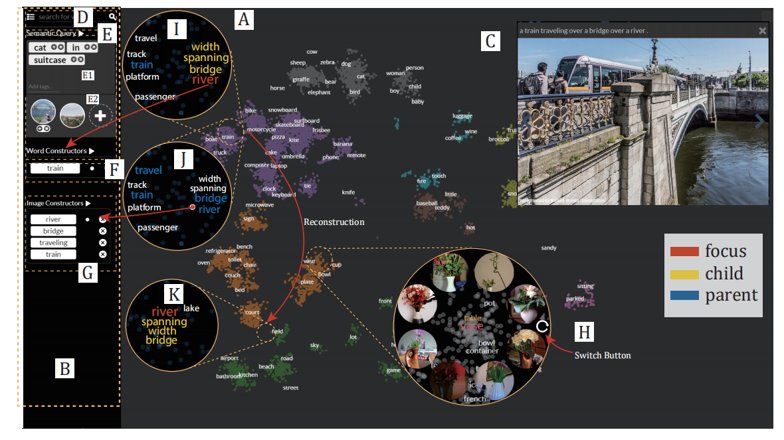
Interface

Slide 14
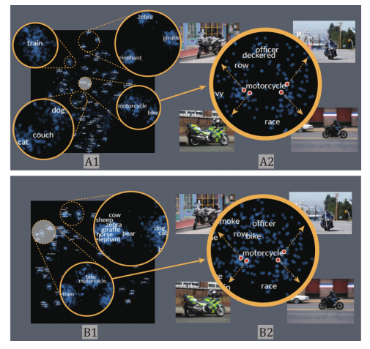
Previous Methods VS Co-embedding

Slide 15
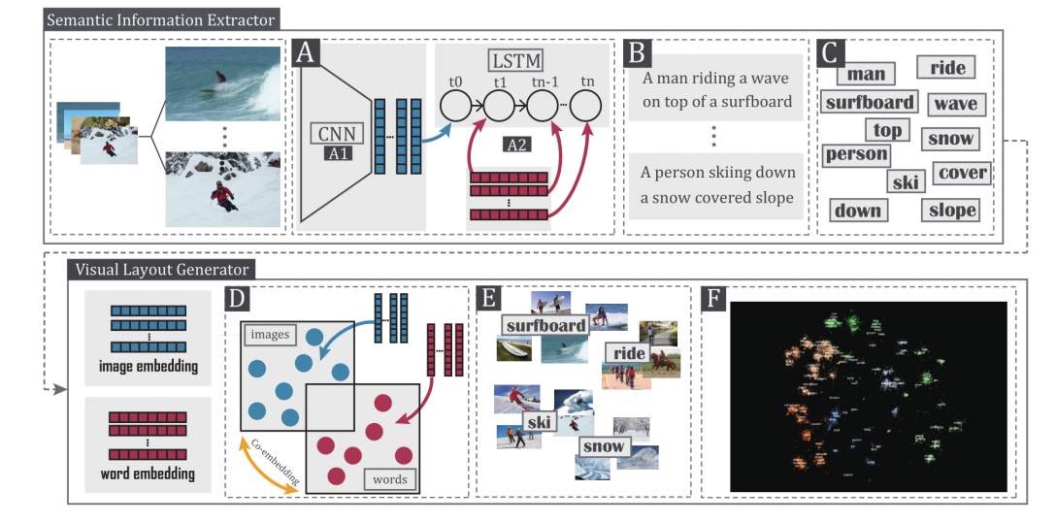
Co-embedding

Slide 16
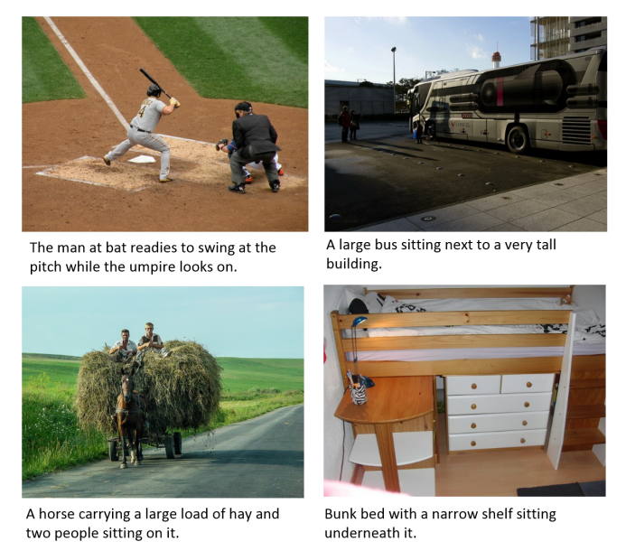

Semantic Information Extract
MSCOCO Dataset ( 80000+ * 5)

Slide 17
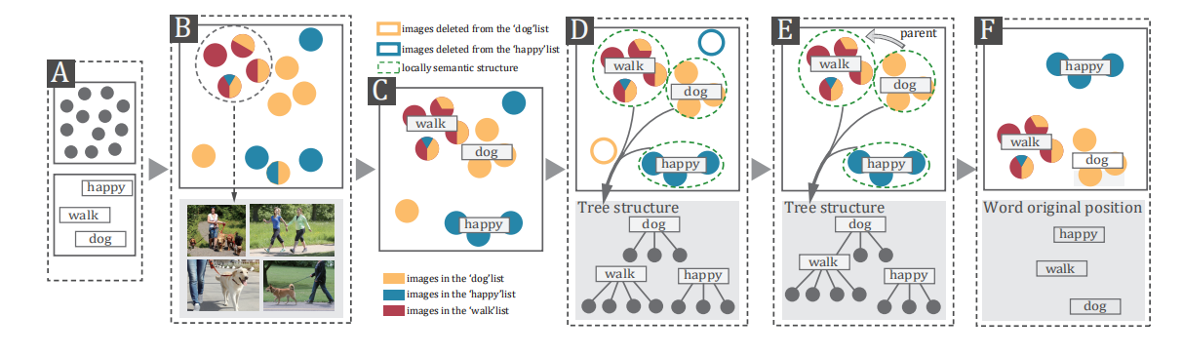
Co-embedding

Slide 18
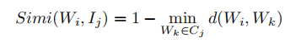
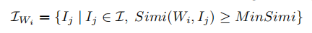
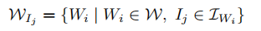
Co-embedding
Obtaining Local Semantic Structures

Slide 19
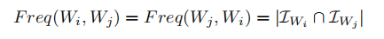
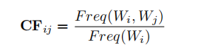
Co-embedding
Reconstruct Images in Semantic Space

Slide 20
“dog” + “cat” + “image of the beach”
“cat” + “in” + “suitcase”

Slide 21
EmotionCues: Emotion-Oriented
Visual Summarization of Classroom Videos
Haipeng Zeng, Xinhuan Shu, Yanbang Wang, Yong Wang,
Liguo Zhang,Ting-Chuen Pong, and Huamin Qu
IEEE Transactions on Visualization and Computer Graphics (2020)

Slide 22
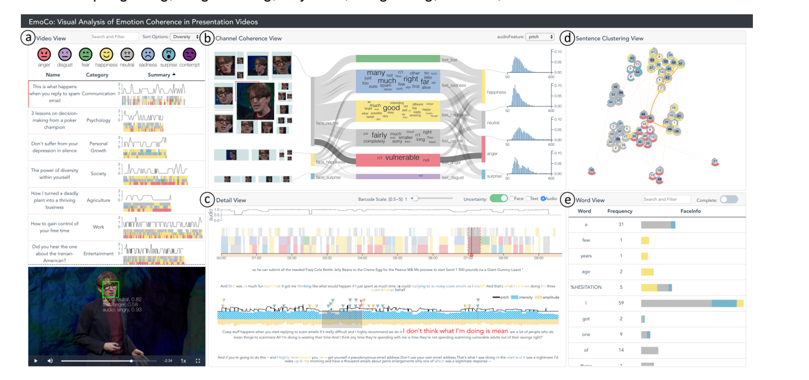
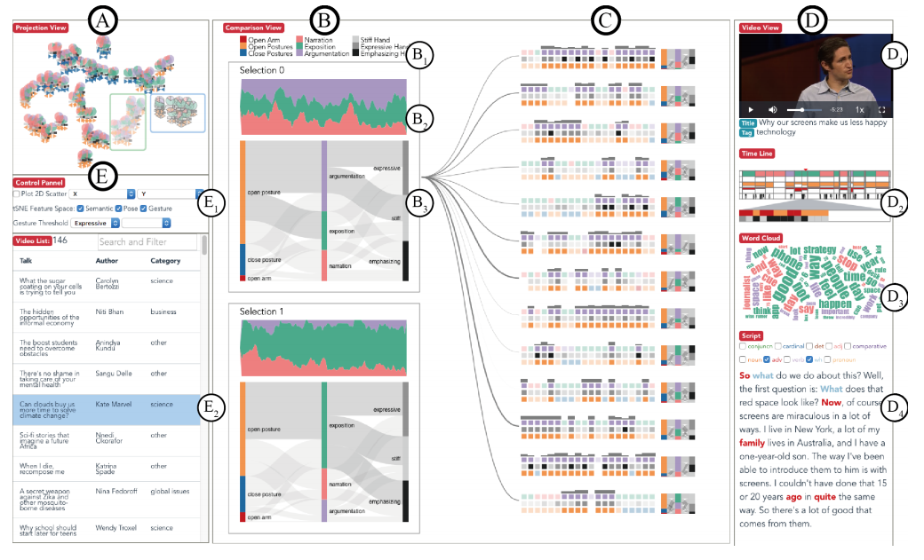
[12]
[13]

Slide 23
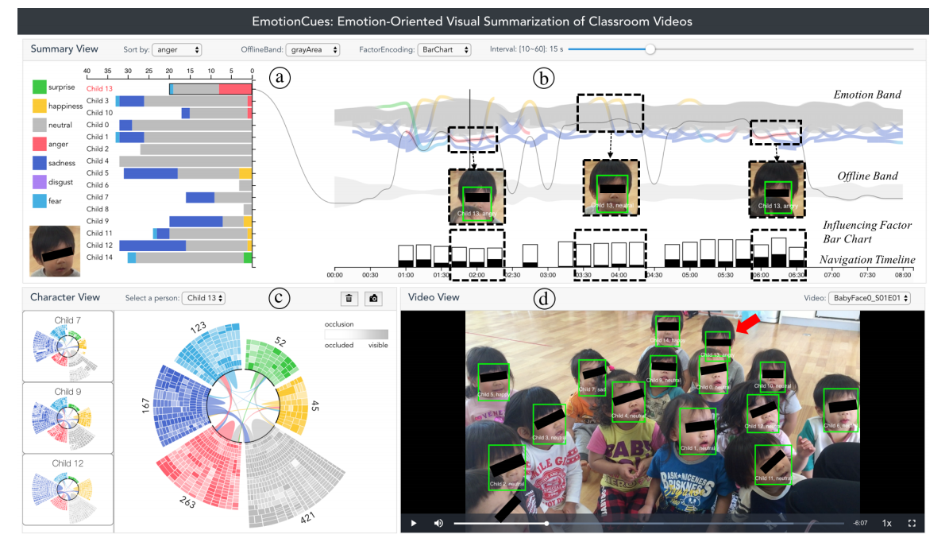
Interface

Slide 24
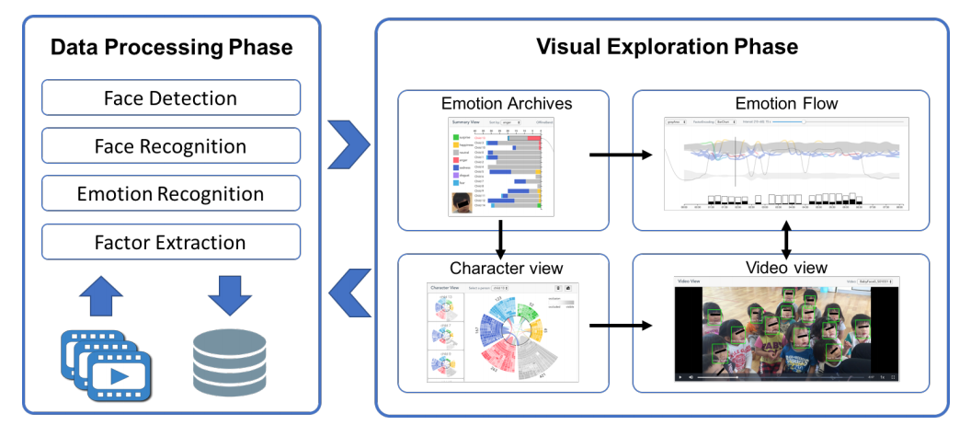
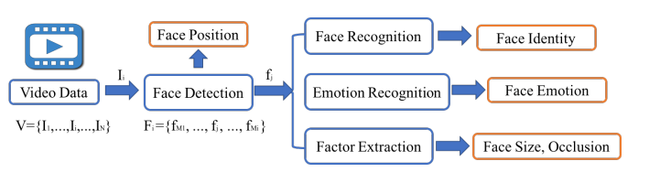
Data Processing Phase
Video Dataset (1.26G 10min 30FPS)
ResNet-50 ( FER 2013 dataset、七种情绪)

Slide 25
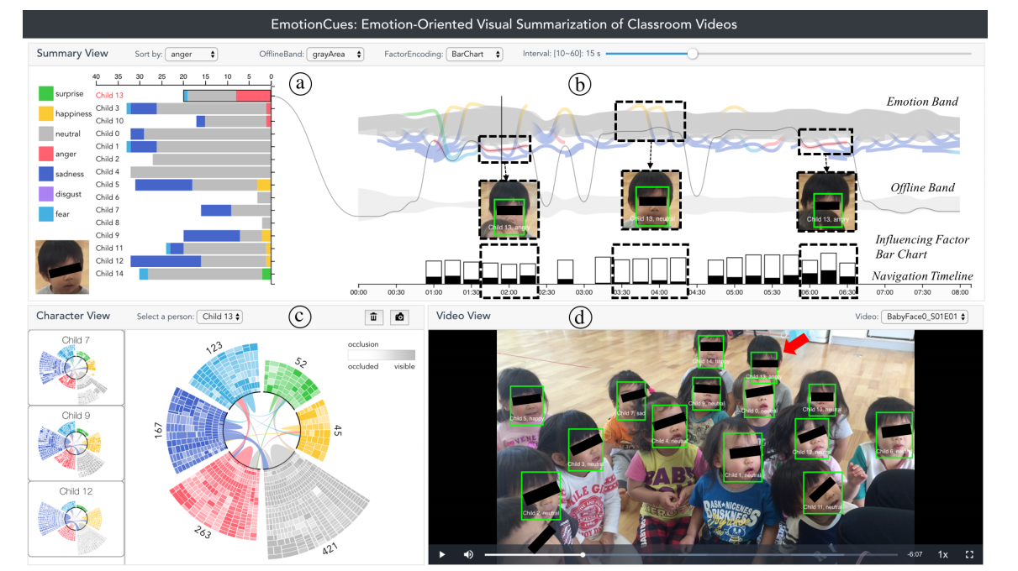
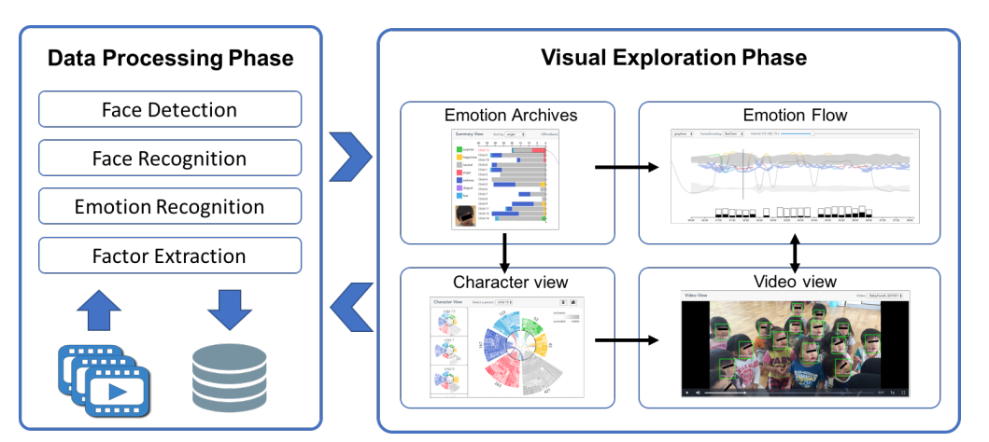
Visual Exploration Phase

Slide 26
References
[1] Krizhevsky, Alex, Ilya Sutskever, and Geoffrey E. Hinton. "Imagenet classification with deep convolutional neural networks." Advances in neural information processing systems. 2012.
[2] Simonyan, Karen, and Andrew Zisserman. "Very deep convolutional networks for large-scale image recognition." arXiv preprint arXiv:1409.1556 (2014).
[3] Szegedy, Christian, et al. "Going deeper with convolutions." Proceedings of the IEEE conference on computer vision and pattern recognition. 2015.
[4] He, Kaiming, et al. "Deep residual learning for image recognition." Proceedings of the IEEE conference on computer vision and pattern recognition. 2016.
[5] Karpathy, Andrej, and Li Fei-Fei. "Deep visual-semantic alignments for generating image descriptions." Proceedings of the IEEE conference on computer vision and pattern recognition. 2015.
[6] Wu, Zuxuan, et al. "Deep learning for video classification and captioning." Frontiers of multimedia research. 2017. 3-29.

Slide 27
[7] Yue-Hei Ng, Joe, et al. "Beyond short snippets: Deep networks for video classification." Proceedings of the IEEE conference on computer vision and pattern recognition. 2015.
[8] Naik, Juhi. "DeepVideo: Video Summarization using Temporal Sequence Modelling."
[9] Zhang, Ke, et al. "Video summarization with long short-term memory." European conference on computer vision. Springer, Cham, 2016.
[10] Venugopalan, Subhashini, et al. "Translating videos to natural language using deep recurrent neural networks." arXiv preprint arXiv:1412.4729 (2014).
[11] Xiong, Yilei, Bo Dai, and Dahua Lin. "Move forward and tell: A progressive generator of video descriptions." Proceedings of the European Conference on Computer Vision (ECCV). 2018.
[12] Zeng, Haipeng, et al. "EmoCo: Visual analysis of emotion coherence in presentation videos." IEEE Transactions on Visualization and Computer Graphics 26.1 (2019): 927-937.
[13] Wu, Aoyu, and Huamin Qu. "Multimodal analysis of video collections: Visual exploration of presentation techniques in ted talks." IEEE Transactions on Visualization and Computer Graphics (2018).

